Slide 2
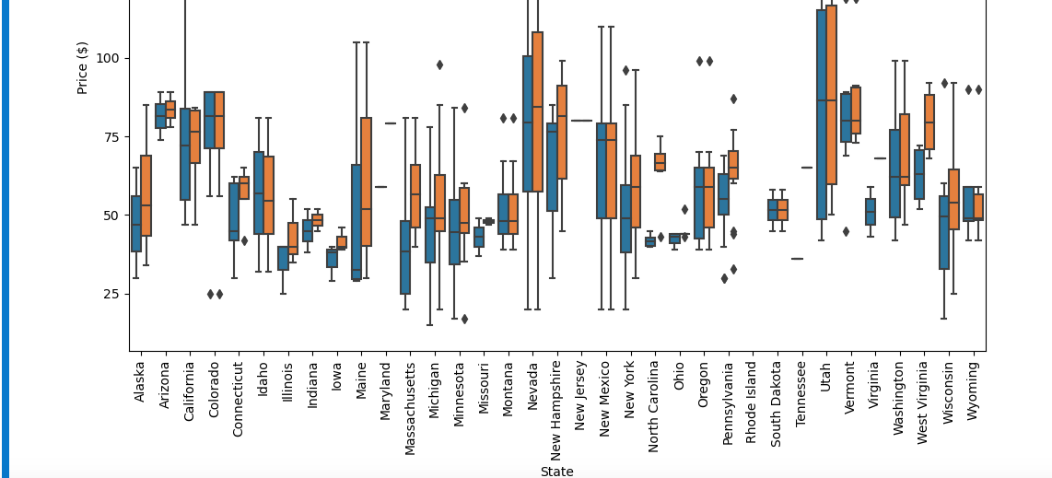
Price analysis across different states

Slide 3
Key Findings
About 16% of data is missing.
It would have been helpful to know the number of visitors the resorts get and the operating costs and other expenditures of each of the resorts.
Random forest offered the most usable model with a mean error of 10% and a $9 ticket price change based for our training and test data. That allowed a $14 price increase when applied on our dataset.
Big Mountain is a leader in Vertical drop, snow making area, number of chairs, fast quads, runs, longest run and skiable area
For any scenarios, the API to call in the model is predict_increase() which takes a feature and the numerical change on that feature, runs it through the model to predict the price change.
Scenario #2 offers the best solution based on this model. It allows for a $1.99 price change and $3.5M in revenue.
Another interesting finding from the model is, if there is a need to close the runs, it should be done one at a time or there will need to be a drastic change in ticket price.
The resort is in Montana where people value the features they get for the ticket price. This is the basis for the previous suggestion generated from the model

